Slide 1
Northeastern library
Robins Ranjan Midhun Santhosh Chandra
Adithya Anand

Slide 2
agenda
Problem Statement
What’s the system used for?
Which issue has it solved?
Use Case Diagram
Class Diagram
Demo of the Application

Slide 3

Manual library management is often slow, and hard to track. The library management system automates these tasks, making it easy to manage books, track inventory, and handle users efficiently. It saves time, improves accuracy, and ensures smooth operations for students and administrators.
Problem Statement

Slide 4
What’s the system used for?
This library management system simplifies tasks like logging in, adding books, searching for books, viewing the book list, lending books, and creating a record for the issued books. It helps students and administrators manage library activities easily and efficiently.

Slide 5
Which issue has it solved?
The system addresses issues like manual book tracking, inefficient search and retrieval processes, and challenges in maintaining records of issued and returned books. It eliminates the need for manual data entry and reduces the chances of errors, saving time and resources for library staff.

Slide 6
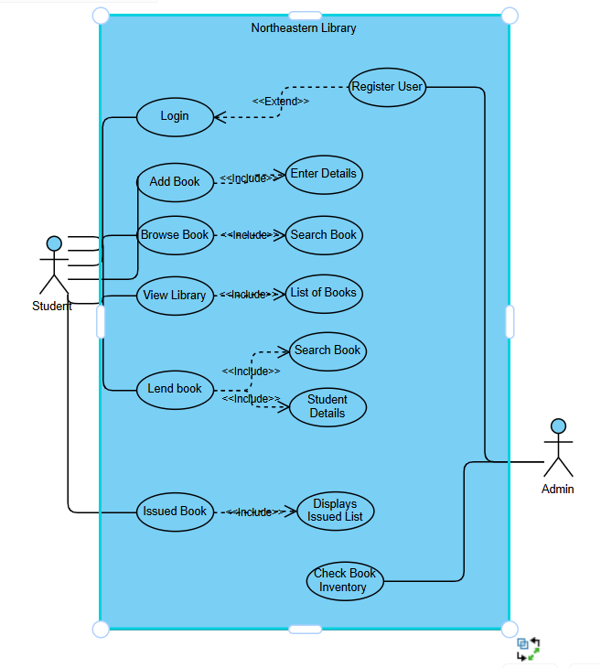
USE CASE Diagram

Slide 7
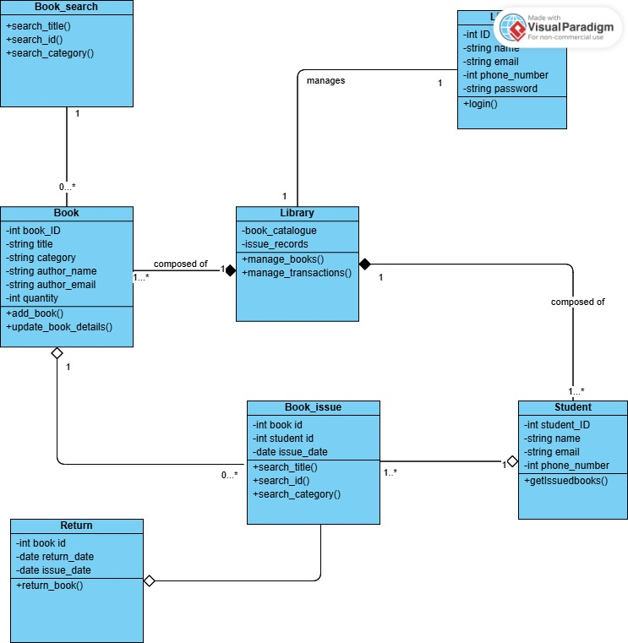
Class diagram

Slide 8
DEMO OF THE APPLICATION

